Slide 1

SAP ZALARIS Integration
Date: 28/06/2022

Slide 2


Steps To Enable Zalaris functionality into the PO Application.
Please follow the below mentioned steps :
Go to the Organization Settings.
In Organization Setup open General Settings.

Slide 3
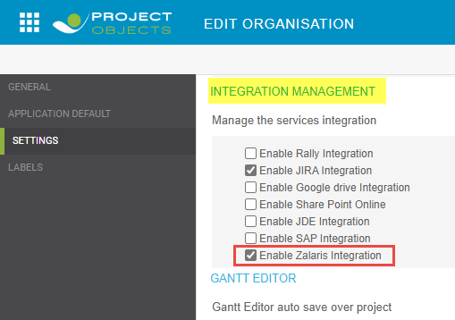
In Settings tab under Integration Management section set enable “Enable Zalaris Integration” Check box.

Slide 4
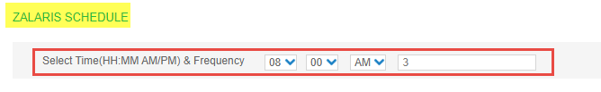

Now to set the information transfer frequency to Zalaris
In Settings tab under “Zalaris Schedule” section by selecting the required Start Time and frequency of update.
For example : The update starts from 8 : 00 AM and runs every 3 Hours.
Apply and save your changes.

Slide 5
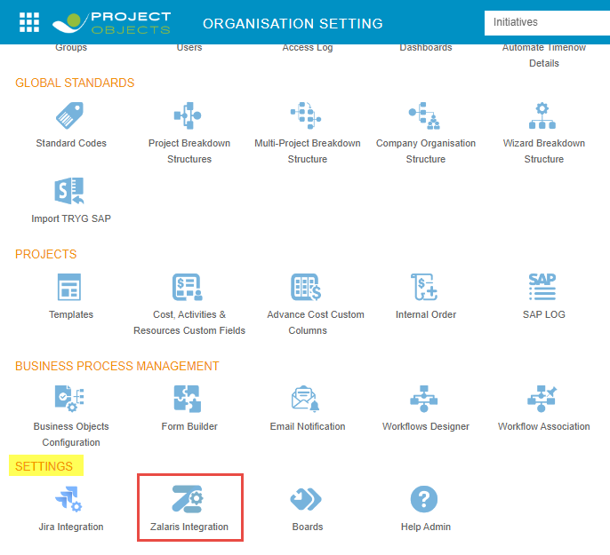
As a result the Zalaris Integration icon will now be visible in Organization Settings under Settings Section.
Click onto the Zalaris integration icon , to Setup the connection settings.

Slide 6
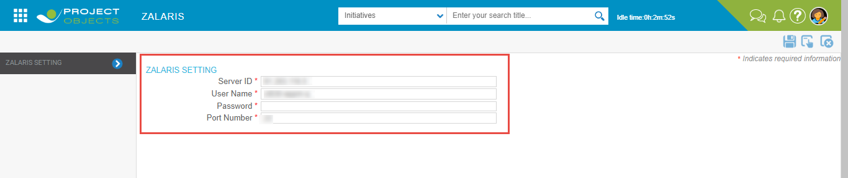
End user is required to Provide the below details
Server ID – Id of requested Zalaris server
Username
Password
Port Number
Apply and save your changes.

Slide 7
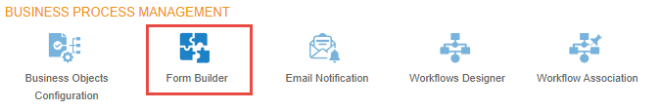
Steps To setup Project Form with Zalaris setting
Go to Form Builder setting under Business Process Management section.

Slide 8
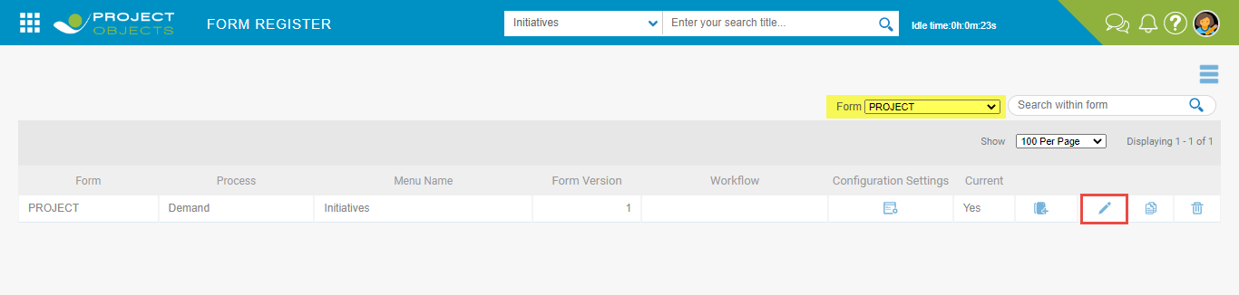
Select Project form as per your requirement and click onto the Edit form button.

Slide 9
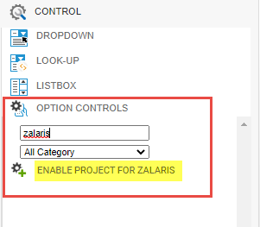
The form builder will be invoked where you can find the new developed control “ENABLE PROJECT FOR ZALARIS” in left pane under Option Controls Setting.

Slide 10
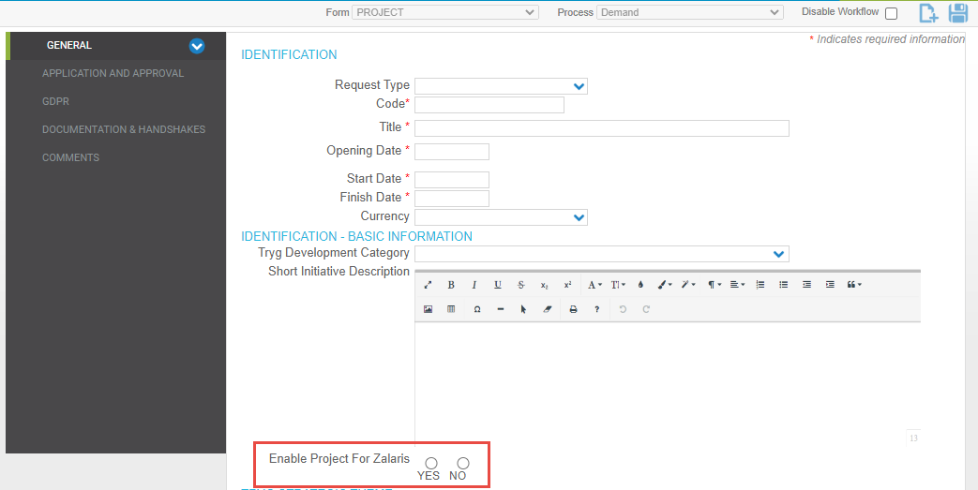
Drag and drop the control onto the form Surface as per your preference. For example, in General tab
Save your changes.

Slide 11
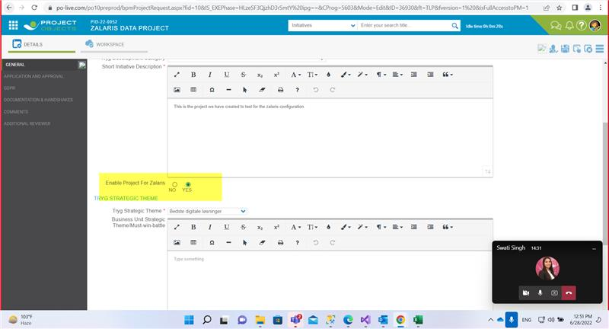
The Radio Button now will be available into the Project Detail page as shown in below image.
Note : The data of projects will be transferred to Zalaris where the highlighted field is marked as “Yes” only.

Slide 12
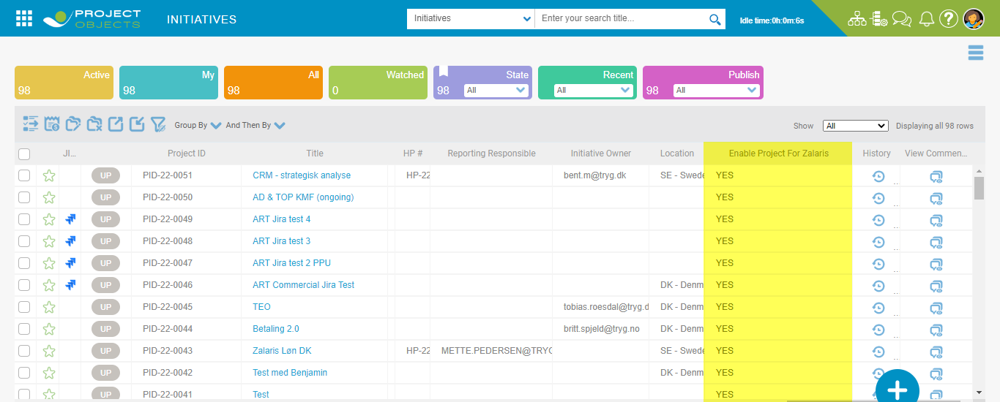
Similarly, the field will be available onto the Project Register page as well.

Slide 13
The information will be updated to Zalaris for the below mentioned fields.
Project Definition ← Code
Project short description ← Title of Project
Start date project & End date of project – It will be updated in zalaris if the project is modified from Project Details , Gantt Editor or Schedule view widget of workspace in DD.MM.YYYY format.
Currency
WBS element ←project number combined with HP Number (Code+HP#)
Description
Company code ← code as per location selection Norway as 4000 & Sweden as 3210
System Status – The Job runs every Hour to update the Project if moved to Closed State to Zalaris as per shared document. (CLSD for Closed only & REL as default)
Employee ID ←Initiative owner
Employee number

